Slide 1
COST Fin AI Country Update- July 2024
Netherlands
Jörg Osterrieder, Marcos Machado, Wouter van Heeswijk, Frédérik Sinan Bernard

Slide 2
Netherlands
Netherlands MC Members:
Ronald Kleverlaan is Director at European Center for Alternative Finance at Utrecht University
Cornelis Oosterlee is Professor of Mathematics at Delft University
Total 10 members (2 Female, 8 Male) for all Working Groups: WG 1, WG 2, WG 3.
Dr. Simon TRIMBORN, WG 1
Mr. Ronald KLEVERLAAN , WG 1
Dr. Friedemann POLZIN, WG 1, WG 3
Mr. Stijn VAN DER POL, WG 1, WG 2, WG 3
Dr. Wouter VAN HEESWIJK, WG 1, WG 2, WG 3
Dr. Xiaohong HUANG, WG 1
Dr. Frédérik Sinan BERNARD, WG 1, WG 2
Dr. Thomas WALTHER, WG 2
Dr. Ekaterina SVETLOVA, WG 2, WG 3
Dr. Marcos MACHADO, WG 2

Slide 3
Netherlands
  COST action events of members
Organization : COST FinAI Doctoral Training School and Research Workshop
  2023
  June 10 to June 14 2024 (Jörg, Marcos, Christina, Fred)
Participation: COST FinAI meets Brussels, COST FinAI meets Istanbul, COST FinAI meets Coimbra, COST FinAI meets Gran Canaria, COST FinAI meets Iceland, COST FinAI meets Naples

Slide 4
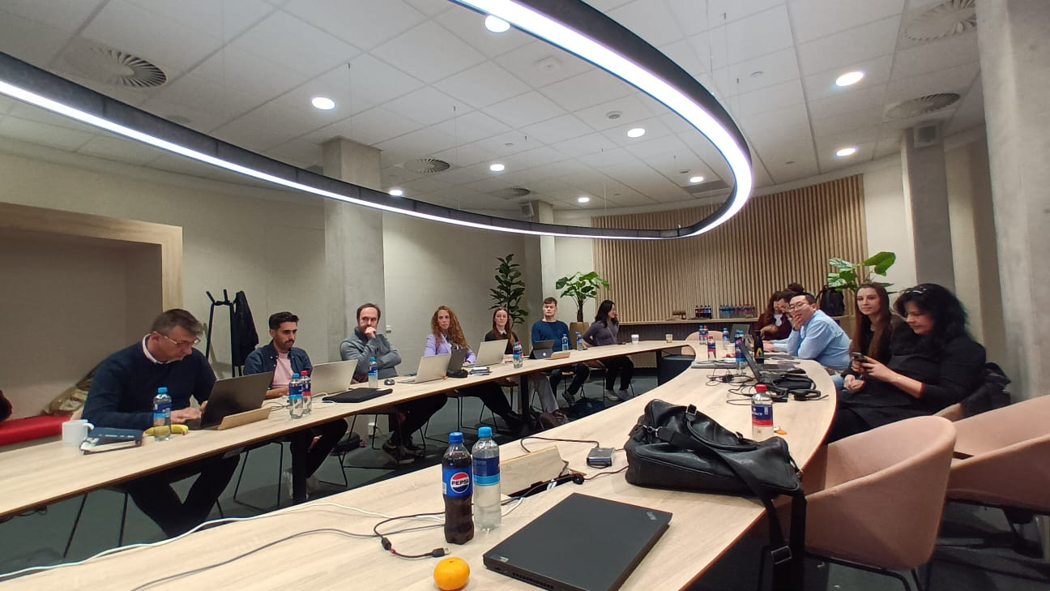
Netherlands
  COST FinAI Doctoral Training School and Research Workshop - June 10 to June 14 2024
The conference took place at the VIP conference room of the Ravelijn building of the University of Twente, which is located in Enschede, Netherlands.
The presentations from WG1, WG2, WG3,
and a Core group meeting on COST FinAI
Topics were featured during the 4 day event.
All speakers and participants were from
COST FinAI, with a focus on those with
active participation.
There were 0.5 of a day talks including PhD
presentations on topics related to WG1 and
WG3. 0.25 day working session for drafting
D7 a DP on the methodology used by P2P
and crowdfunding regarding fraud detection.

Slide 5
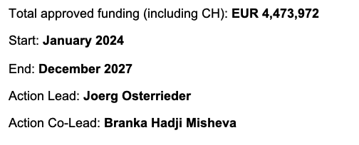
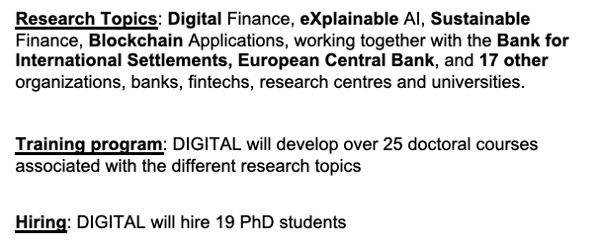
Netherlands
Applications - MSCA DN Action

Slide 6

Netherlands
Applications - MSCA DN Action
Banks & Fintechs
International Organisations
Faculties
Research Centers

Slide 7
Netherlands
Papers
Literature reviews: “fraud”in the context of :
  ICO
  Crowdfunding
  P2 lending platforms
Papers with COST acknowledgment
  Amato, A., Osterrieder, J. R., & Machado, M. R. (2024). How can artificial intelligence help customer intelligence for credit portfolio management? A systematic literature review. International Journal of Information Management Data Insights, 4(2), 100234.
  M. Moloney, E. Svetlova, C. Muckley, E. Paschalidou, I. Coita, V. Poti. Assessing AI and data protection expertise in academia and the financial services sector: Insights and recommendations for AI skills development (2023). Journal of Financial Transformation, 58, 160-167.
  Osterrieder J, Hadji Misheva B, Machado M. Digital Finance: Reaching New Frontiers. Open Res Eur. 2023 Feb 23;3:38. doi: 10.12688/openreseurope.15386.1. PMID: 37645501; PMCID: PMC10445873.
Under review
  Machado, Marcos and Osterrieder, Joerg and Amato, Alessandra, Integrating Early Warning Systems with Customer Segmentation: An Information Management Approach to Identifying Business Opportunities for Commercial Customers in the Financial Industry (March 31, 2024). Available at SSRN: https://ssrn.com/abstract=4779632
  Kozian, Luca and Osterrieder, Joerg and Machado, Marcos, Modeling Commodity Price Co-Movement: Building on Traditional Methods & Exploring Applications of Machine Learning Models (January 8, 2024). Available at SSRN: https://ssrn.com/abstract=4730474 or http://dx.doi.org/10.2139/ssrn.4730474
  Machado, Marcos and Osterrieder, Joerg and van Braak, Bjoern, How can Consumers Without Credit History Benefit from the Use of Information Processing and Machine Learning Tools by Financial Institutions? (February 1, 2024). Available at SSRN: https://ssrn.com/abstract=4730445
  Beltman, Jaap and Osterrieder, Joerg and Machado, Marcos, Predicting Retail Customers' Distress: Early Warning Systems and Machine Learning Applications (January 18, 2024). Available at SSRN: https://ssrn.com/abstract=4730470 or http://dx.doi.org/10.2139/ssrn.4730470

Slide 8
Netherlands
Actions Planned:
  Erasmus+ nextGen ESG application in 2023 to be revised with leadership of Maria Ianario in October 2024
  Clutser of Bilateral Erasmus+ mobility applications with COST members (notably with MSCA DIGITAL partners)
  New COST application (Sustainable Digital Finance) to be submitted in October 2024
Contributions to COST action activities:
    Contributions to D16
    Contributions to D7

Slide 9
Netherlands
  Non-COST action events of members
FinanceCom2022
ING
MSCA Digital Finance: KickOff in January 2024

